Slide 1





G8T9 Y W L T C
PM Review
Christine | Lifu | Tee Yong | Wang Ting | Yu Liang

Slide 2



Functionalities

Slide 3
Do you plan to drop/add any functionalities?
Not dropping any functionalities
Yes, we plan to add functionalities
Starting with recommended ones after completing required functions
Timetable
Search
Consideration for other functions will depend on progress

Slide 4
Do you plan to use any PHP frameworks?
Didn’t use in Iter 1
Plan to utilize PHP frameworks in future iterations (need to learn)

Slide 5
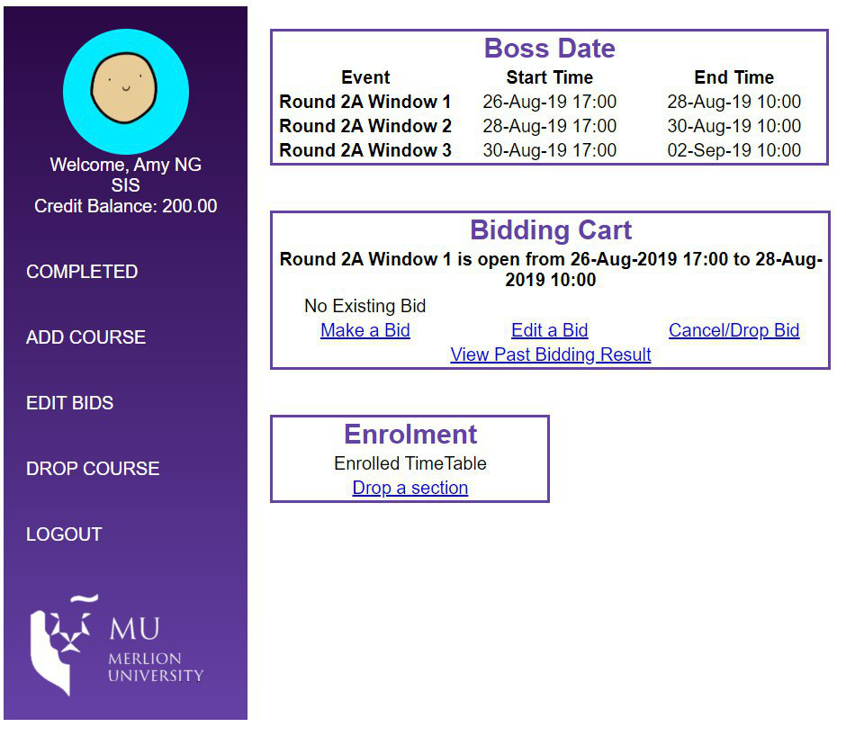

Did you manage to finish login + 1 functionality?
Login : Yes

Slide 6
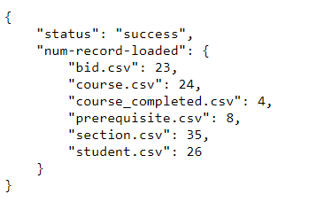
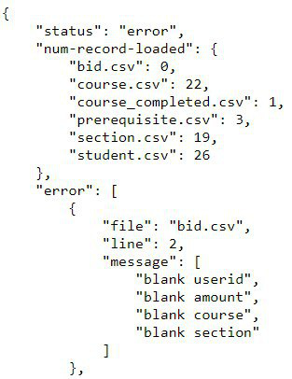

Did you manage to finish login + 1 functionality?
1 Functionality - Bootstrap
Largely complete
(with validation)
(yet to implement bidding rounds)

Slide 7
What is the IP address & admin password for your cloud deployment?
Admin password = P@ssw0rd!547
Cloud IP Address = 13.58.117.140

Slide 8
Schedule

Slide 9
Project Overall Schedule
Iteration 1 – Login + Bootstrap + Basic UI design
Iteration 2 – Finish all required functionalities
Iteration 3 – Develop additional features + finish UI
Iteration 4 – Fix any bugs, UI, app finalization & deployment
Iteration 5 – Final Presentation

Slide 10
Project Schedule
Iteration 1
(Login + Bootstrap)
Week 5 – Week 6
Week 7 – Week 8
Week 9 – Week 10
Week 11 – Week 13
W5
W6
W7
W8
W9
W10
W11
W12
W13
Completed
Iteration 2
(Rounds + user functionalities)
Not started
Iteration 3
(Prepare for user testing)
Not started
Iteration 4
(Develop additional features)
Not started
Iteration 5
(Finishing touch + presentation)
Not started
LEGEND
PLANNED
ACTUAL

Slide 11
Iteration 1 (17/9 – 1/10)
PLANNED TASKS
SQL + Objects & DAOs
Iteration 1
20/9
21/9
22/9
23/9
24/9
25/9
26/9
27/9
28/9
29/9
30/9
31/9 – 1/10
Completed
UI ideation & implementation
Completed
Completed
Login + database connection
Completed
Main page + Logout
Completed
Bootstrap & Testing
HOLD
HOLD
Completed
Completed
Deployment + PM Review
Completed
LEGEND
SCHEDULED
ACTUAL

Slide 12
Iteration 2 (2/10 – 15/10)
PLANNED TASKS
JSON Validations
Iteration 2
2/10 – 3/10
4/10
5/10
6/10
7/10
8/10
9/10
10/10
11/10
12/10
13/10
14/10 - 15/10
Rounds
Add / Drop Bid / Section
Additional Feature
Testing & Deployment
Others
LEGEND
PLANNED
ACTUAL

Slide 13
Iteration 3 (16/10 – 29/10)
PLANNED TASKS
Incomplete / Additional features
Iteration 3
16/10
17/10
18/10
19/10
20/10
21/10
22/10
23/10
24/10
25/10
26/10
27/10 - 29/10
Organizing, tidying up
Testing
Presentation Preparation
Deployment
Others
LEGEND
PLANNED
ACTUAL

Slide 14
Iteration 4 (30/10 – 9/11)
PLANNED TASKS
Fixing features & UI
Iteration 4
30/10
31/10
1/11
2/11
3/11
4/11
5/11
6/11
7/11
8/11
9/11
Organizing, tidying up
Testing
Deployment
Preparation
LEGEND
PLANNED
ACTUAL

Slide 15
Iteration 5 (9/11 – 19/11)
PLANNED TASKS
Presentation Preparation
Iteration 5
10/11
11/11
12/11
13/11
14/11
15/11
16/11
17/11
18/11
19/11
Deployment & Submission
Presentation
LEGEND
PLANNED
ACTUAL

Slide 16
What are your milestones?
Milestone 1 – PM Review
Milestone 2 – In-class Demo
Milestone 3 – User Acceptance Test
Milestone 4 – Deployment
Milestone 5 – Final Presentation

Slide 17
Iteration 1 Critical Path
1
3
3
3.1.1
0
13
14
2
5
0
Task ID | Description | Effort
3.1.1 | Create SQL | 3
3.2.1 | Create objects & DAOs | 2
3.2.2 | Set up connection to database | 1
3.3.1 | Create Login | 1
3.4.2 | Create Main page & Logout | 3
3.4.1.2 | Create Login Page UI | 3
3.5.1.1 | Create Bootstrap without validation | 1
3.5.1.2 | Create Bootstrap with validation | 2
5 | Deployment | 2
1
3
13
14
4
5
4
4
2
3.2.1
0
1
3.2.2
1
11
12
7
9
2
3.5.1.2
0
3
3.4.1.2
3
4
5
5
5
11
12
10
12
6
1
3.3.1
0
6
7
9
10
10
3
3.4.2
0
1
3.5.1.1
0
6
6
7
9
10
10

Slide 18
How much buffer time do you have?
4 days

Slide 19
Bug Metrics

Slide 20
Bug Metrics
Total: 27
S/N | Description | Severity | Status
1 | UI - Poor visibility for login page (black text on dark purple BG) | 1 – Low | Resolved
2 | ProcessLogin - Process login failed to redirect to targeted page | 5 – High | Resolved
3 | Bootstrap - Checked wrong columns for pre-requisite.csv | 5 – High | Resolved
4 | Bootstrap – errors output not sorted accordingly to requirements | 1 – Low | Resolved
5 | Login (admin) - No logout button in bootstrap.php after admin login | 5 – High | Resolved
6 | Bootstrap – does not work on AWS | 10 - Critical | Unresolved

Slide 21
Roles & Responsibilities

Slide 22
Iteration 1 – Roles & Responsibilities
Project Manager – Huang Lifu
Coding Team 1 – Yu Liang & Tee Yong
Coding Team 2 – Wang Ting & Christine

Slide 23
Pair Programming Teams & Rotation Plan

Slide 24
Pair Programming Teams & Rotation Plan
Iteration | Project Manager | Programming Pairs
1 | Lifu | Yu Liang & Tee Yong Wang Ting & Christine
2 | Wang Ting | Lifu & Tee Yong Yu Liang & Christine
3 | Christine | Yu Liang & Lifu Tee Yong & Wang Ting
4 | Tee Yong | Lifu & Christine Yu Liang & Wang Ting
5 | Yu Liang | N/A

Slide 25

Thank you!

